Slide 2
Objectives
Explain scripting
Explain the JavaScript language
Explain the client-side and server-side JavaScript
List the variables and data types in JavaScript
Describe the JavaScript methods to display information
Explain escape sequences and built in functions in JavaScript
Explain events and event handling
Explain jQuery
Describe how to use the jQuery Mobile

Slide 3
Scripting 1-2
Scripting refers to a series of commands that are interpreted and executed sequentially and immediately on occurrence of an event.
This event is an action generated by a user while interacting with a Web page.
Examples of events include button clicks, selecting a product from a menu, and so on.
A scripting language refers to a set of instructions that provides some functionality when the user interacts with a Web page.
Scripting languages are often embedded in the HTML pages to change the behavior of the Web pages according to the user’s requirements.

Slide 4
Scripting 2-2
There are two types of scripting languages. They are as follows:
Client-side Scripting:
Server-side Scripting:
Refers to a script being executed on the client’s machine by the browser.
Refers to a script being executed on a Web server to generate dynamic HTML pages.

Slide 5
JavaScript
JavaScript is a scripting language that allows building dynamic Web pages by ensuring maximum user interactivity.
JavaScript is an object-based language, which means that it provides objects for specifying functionalities.
In real life, an object is a visible entity such as a car or a table having some characteristics and capable of performing certain actions.
Similarly, in a scripting language, an object has a unique identity, state, and behavior.
The identity of the object distinguishes it from the other objects of the same type.
The state of the object refers to its characteristics, whereas the behavior of the object consists of its possible actions.
The object stores its identity and state in fields (also called variables) and exposes its behavior through functions (actions).
Notes:
Specify : xác định
Visible ; hữu hình

Slide 6
Versions of JavaScript
The first version was developed by Brendan Eich at Netscape in 1995 and was named JavaScript 1.0.
^{Version} | ^{Description}
1.1 | Is supported from 3.0 version of the Netscape Navigator and IE.
1.2 | Is supported by the IE from version 4.0.
1.3 | Is supported by the IE from version 5.0, Netscape from version 4.0, and Opera from version 5.0.
1.4 | Is supported by servers of Netscape and Opera 6.
1.5 | Is supported by the IE from version 6.0, Netscape from version 6.0, and Mozilla Firefox from version 1.0.
1.6 | Is supported in the latest versions of the IE and Netscape browsers. It is also supported by Firefox from version 1.5.
1.7 | Is supported in the latest versions of the IE and Netscape browsers. It is also supported by Firefox from version 2.0.
Notes:
The latest JavaScript in use is version 1.8.5 released on 27 July, 2010. Ref : https://developer.mozilla.org/en-US/docs/Web/JavaScript/New_in_JavaScript

Slide 7
Client-side JavaScript 1-2
A Client-side JavaScript (CSJS) is executed by the browser on the user’s workstation.
A client-side script might contain instructions for the browser to handle user interactivity.
A JavaScript is either embedded in an HTML page or is separately defined in a file, which is saved with .js extension.

Slide 8
Server-side JavaScript 1-2
A Server-side JavaScript (SSJS) is executed by the Web server when an HTML page is requested by a user and the output is displayed by the browser.
can interact with the database, fetch the required information and display it to the user.
fulfills the goal of providing dynamic content in Web pages.
This machine-independent code is known as the bytecode, which is an executable file that the Web server runs to generate the desired output.
Compilation is a process of converting a code into machine-independent code

Slide 9
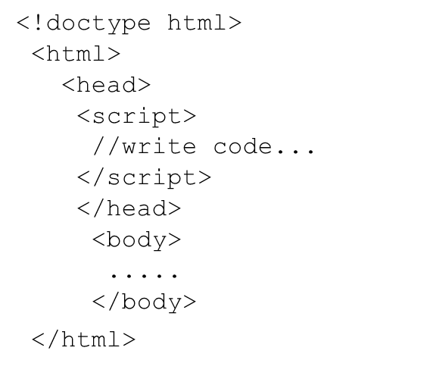
<Script> Tag
The <script> tag defines a script for an HTML page to make them interactive.
The browser that supports scripts interprets and executes the script specified under the <script> tag when the page loads in the browser.
You can define multiple <script> tags either in the <head> or in the <body> elements.
There are two main purposes of the <script> tag:
Identifies a given segment of script in the HTML page.
Loads an external script file.

Slide 10
Declaring Variables 1-2
Declaring a variable refers to creating a variable by specifying the variable name.
name
studID
value
100
type
Number
Syntax:
var <variableName>;
var <variableName1>=<value1>, <variableName2>=<value2>;
Code Snippet:
var studName = “David”, studAge = 15;

Slide 11
Data Types in JavaScript
PRIMITIVE DATA TYPES
contain a single literal value such as a number or a string.
A literal is a static value that you can assign to variables.
Example: boolean, null, number, string
COMPOSITE DATA TYPES
store a collection of multiple related values
In JavaScript, all composite data types are treated as objects.
A composite data type can be either predefined or user-defined
Example: Objects, Functions and Arrays

Slide 12
Method write(), writeln() in Javascript
Javascript allow to display information by using methods of document object
write(): Displays any type of data.
writeln(): Displays any type of data and appends a new line character.
Example:
<!DOCTYPE HTML>
<html>
<head>
<title> JavaScript language </title>
<script>
document.write(“<p> JavaScript:”);
document.writeln(“is a scripting”);
document.write(“and a case-sensitive language.”);
</script>
</head>
<body>
<p> JavaScript: is a scripting & case-sensitive language.</p>
</body>
</html>

Slide 13
Using Comments
Comments provide information about a piece of code in the script.
JavaScript supports two types of comments. These are as follows:
SINGLE LINE COMMENTS
Single-line comments begin with two forward slashes (//).
MULTI-LINE COMMENTS
Multi-line comments begin with a forward slash followed by an asterisk (/*) and end with an asterisk followed by a forward slash (*/).
Example:
/* This line of code
declares a variable */

Slide 14
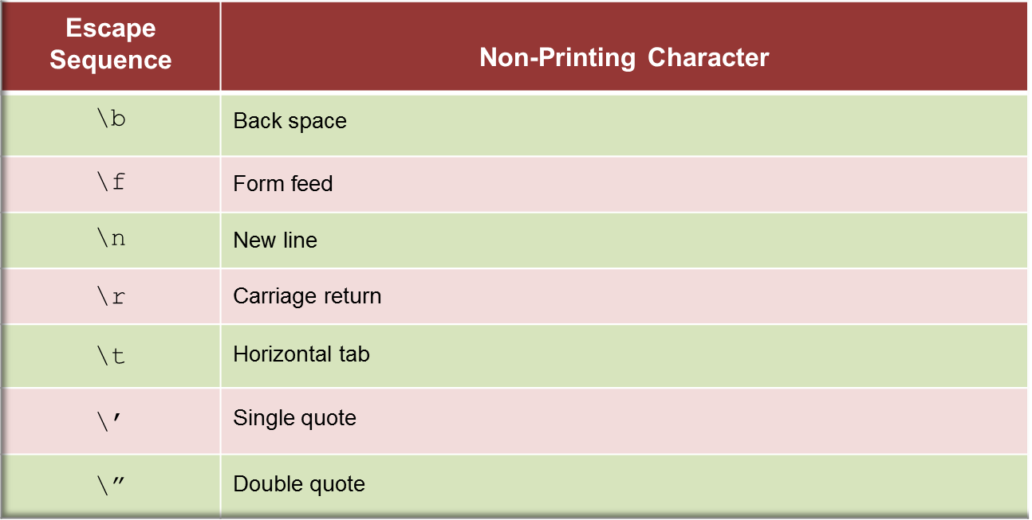
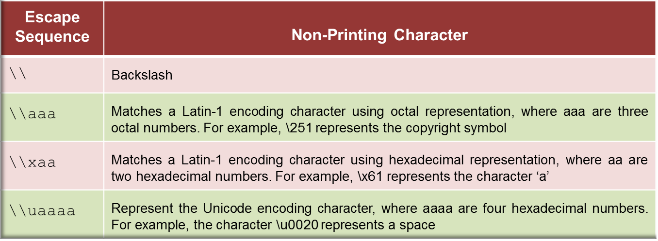
Escape Sequence Characters
<script>
document.write(“You need to have a \u0022credit card\u0022, if you want to shop on the \’Internet\’.”);
</script>

Slide 15
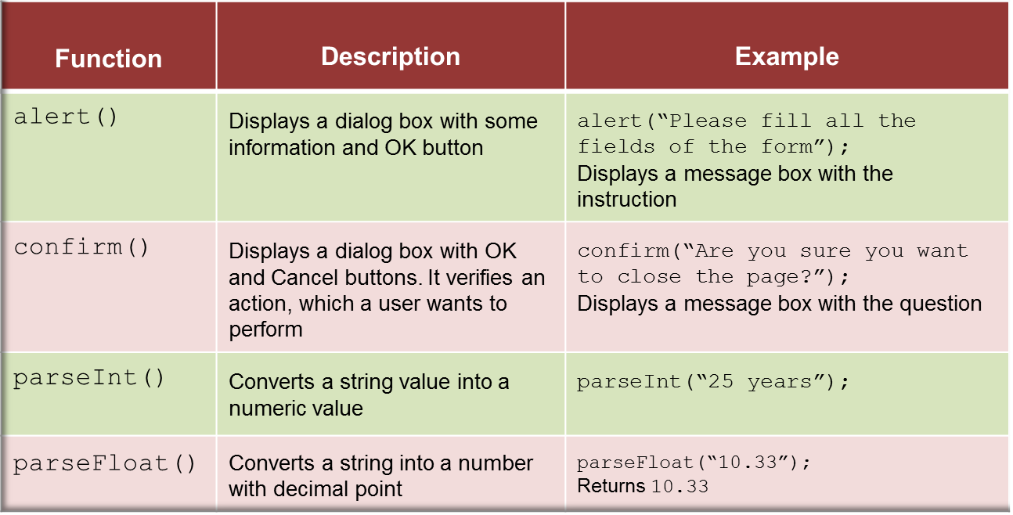
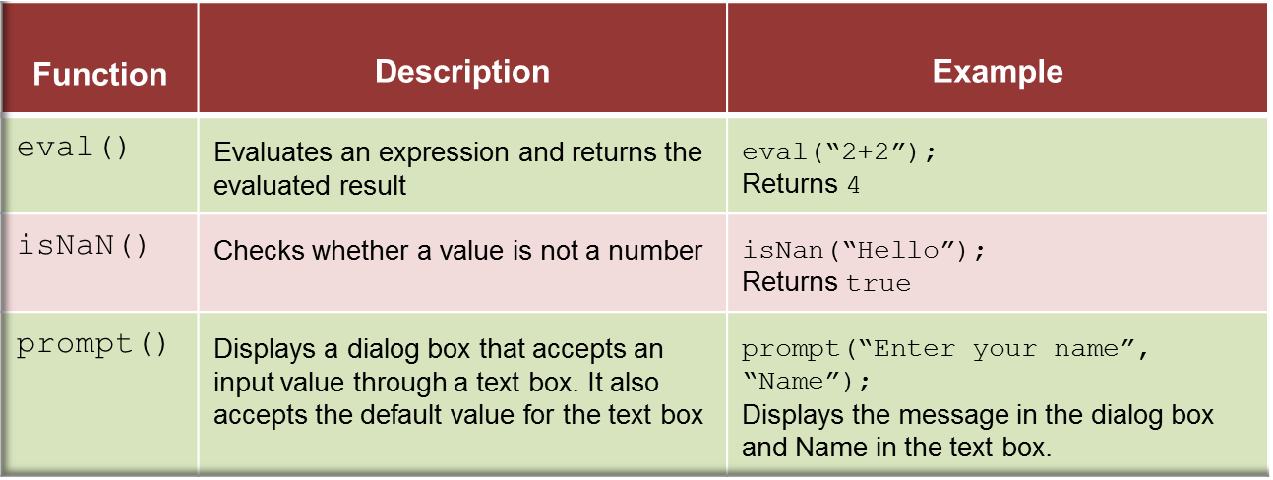
Built-in Function
is a piece of code that performs some operations to fulfill a specific task.
takes one or more input values, processes them, and returns an output value.

Slide 16
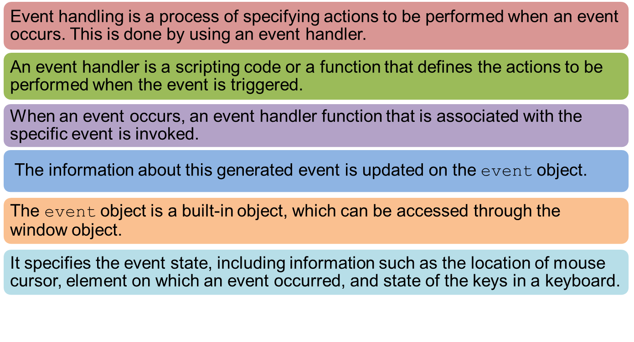
Event Handling

Slide 17
Keyboard Events
occur when a key or a combination of keys are pressed or released from a keyboard.
occur for all keys of a keyboard.
The different keyboard events are as follows:
Onkeydown
Onkeyup
Occurs when a key is pressed down.
Occurs when a key is pressed and released.
Onkeypress
Occurs when the key is released.

Slide 18
Mouse Events
occur when the user clicks the mouse button.
Following table lists the mouse events.
^{Event} | ^{Description}
^{onmousedown} | Occurs when the mouse button is pressed
^{onmouseup} | Occurs when the mouse button is released
^{onclick} | Occurs when the mouse button is pressed and released
^{ondblclick} | Occurs when the mouse button is double-clicked
^{onmousemove} | Occurs when the mouse pointer is moved from one location to other
^{onmouseover} | Occurs when the mouse pointer is moved over the element
^{onmouseout} | Occurs when the mouse pointer is moved out of the element

Slide 19
Focus and Selection Events
The focus events determines the activation of various elements. User can set or reset focus for different elements.
The selection events occur when an element or a part of an element within a Web page is selected.
^{Data Type} | ^{Description}
onfocus | Occurs when an element receives focus
onblur | Occurs when an element loses focus
onselectstart | Occurs when the selection of an element starts
onselect | Occurs when the present selection changes
ondragstart | Occurs when the selected element is moved

Slide 20
jQuery 1-2
jQuery is a short and fast JavaScript library developed by John Resig in 2006 with a wonderful slogan: Write less and do more.
simplifies client-side scripting, animation, event handling, traversing, and developing AJAX based Web applications.
helps in rapid Web application development by writing lesser code.
Key features of jQuery.
Event Handling
Animations
jQuery has a smart way to capture a wide range of events without making the HTML code complex with event handlers.
jQuery easily selects, traverses, and modifies DOM by using the cross-browser open source selector engine named Sizzle.
DOM Manipulation
jQuery has many built-in animation effects that the user can use while developing their Web sites.
Notes:
Versions: 1.0, 1.1.x, 1.2.x, 1.3, 1.4.x, 1.5.x, 1.6, 1.7, 1.8, 1.9, 1.12, 2.2, 3.0, 3.1 . REF: http://jquery.com/download/

Slide 21
jQuery 2-2
Cross Browser Support
Lightweight
jQuery has a support for cross-browser and works well with the following browsers:
jQuery supports basic XPath syntax and CSS3 selectors.
Latest Technology
jQuery has a lightweight library of 19 KB size.
Internet Explorer 6 and above
Firefox 2.0 and above
Safari 3.0 and above
Chrome
Opera 9.0 and above
AJAX Support
jQuery helps you to develop feature-rich and responsive Web sites by using AJAX technologies.

Slide 22
Using jQuery Library
To work with jQuery perform the following steps:
Download the jQuery library from the http://jquery.com/ Web site
Place the jquery-1.7.2.min.js file in the current directory of the Web site.
<!DOCTYPE HTML>
<html>
<head>
<title>The jQuery Example</title>
<script src=”jquery-1.7.2.min.js” >
$(document).ready( function(){
$(“div”).click(function(){
alert(“Welcome JQuery!”);
});
});
</script>
</head>
<body>
<div id=‘first’>Click here !</div>
</body>
</html>

Slide 23
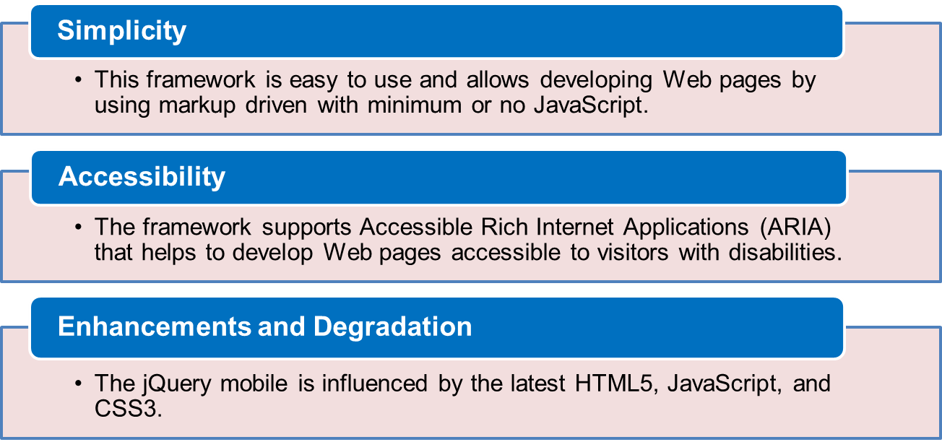
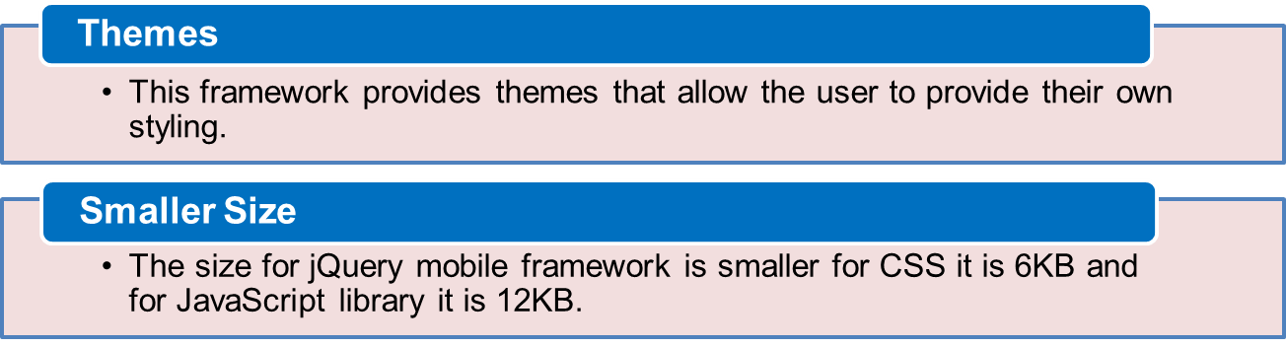
jQuery Mobile
jQuery mobile is a Web User Interface (UI) development framework that allows to build mobile Web applications that work on tablets and smartphones.

Slide 24
Summary
Scripting refers to a series of commands that are interpreted and executed sequentially and immediately on an occurrence of an event.
JavaScript is a scripting language, which can be executed on the client-side and on the server-side.
A variable refers to a symbolic name that holds a value, which keeps changing.
A primitive data type contains a single literal value such as a number, a string.
A function is a piece of code that performs some operations on variables to fulfill a specific task.
Event handling is a process of specifying actions to be performed when an event occurs.
Event bubbling is a mechanism that allows you to specify a common event handler for all child elements.
jQuery mobile is a Web User Interface development framework that allows the user to build mobile Web applications that works on tablets and smartphones.

